Slide 1
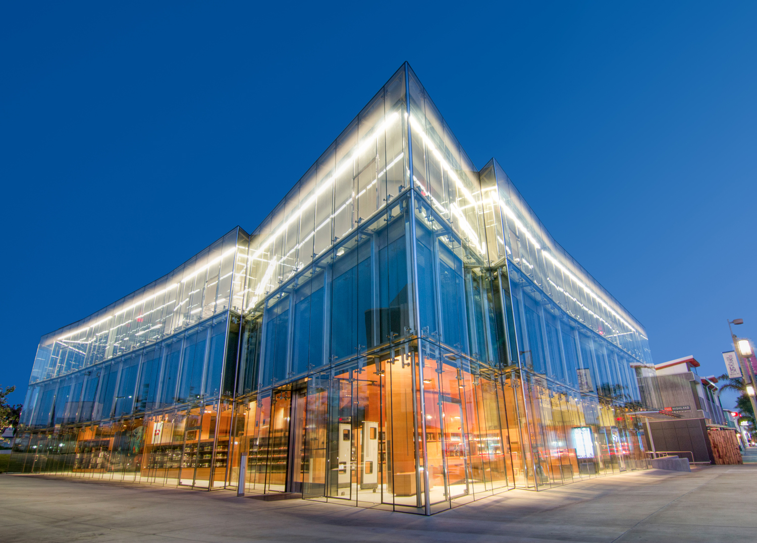
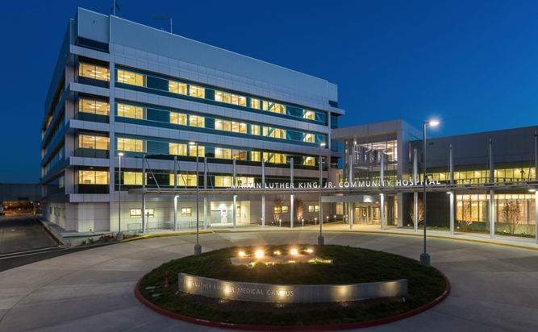
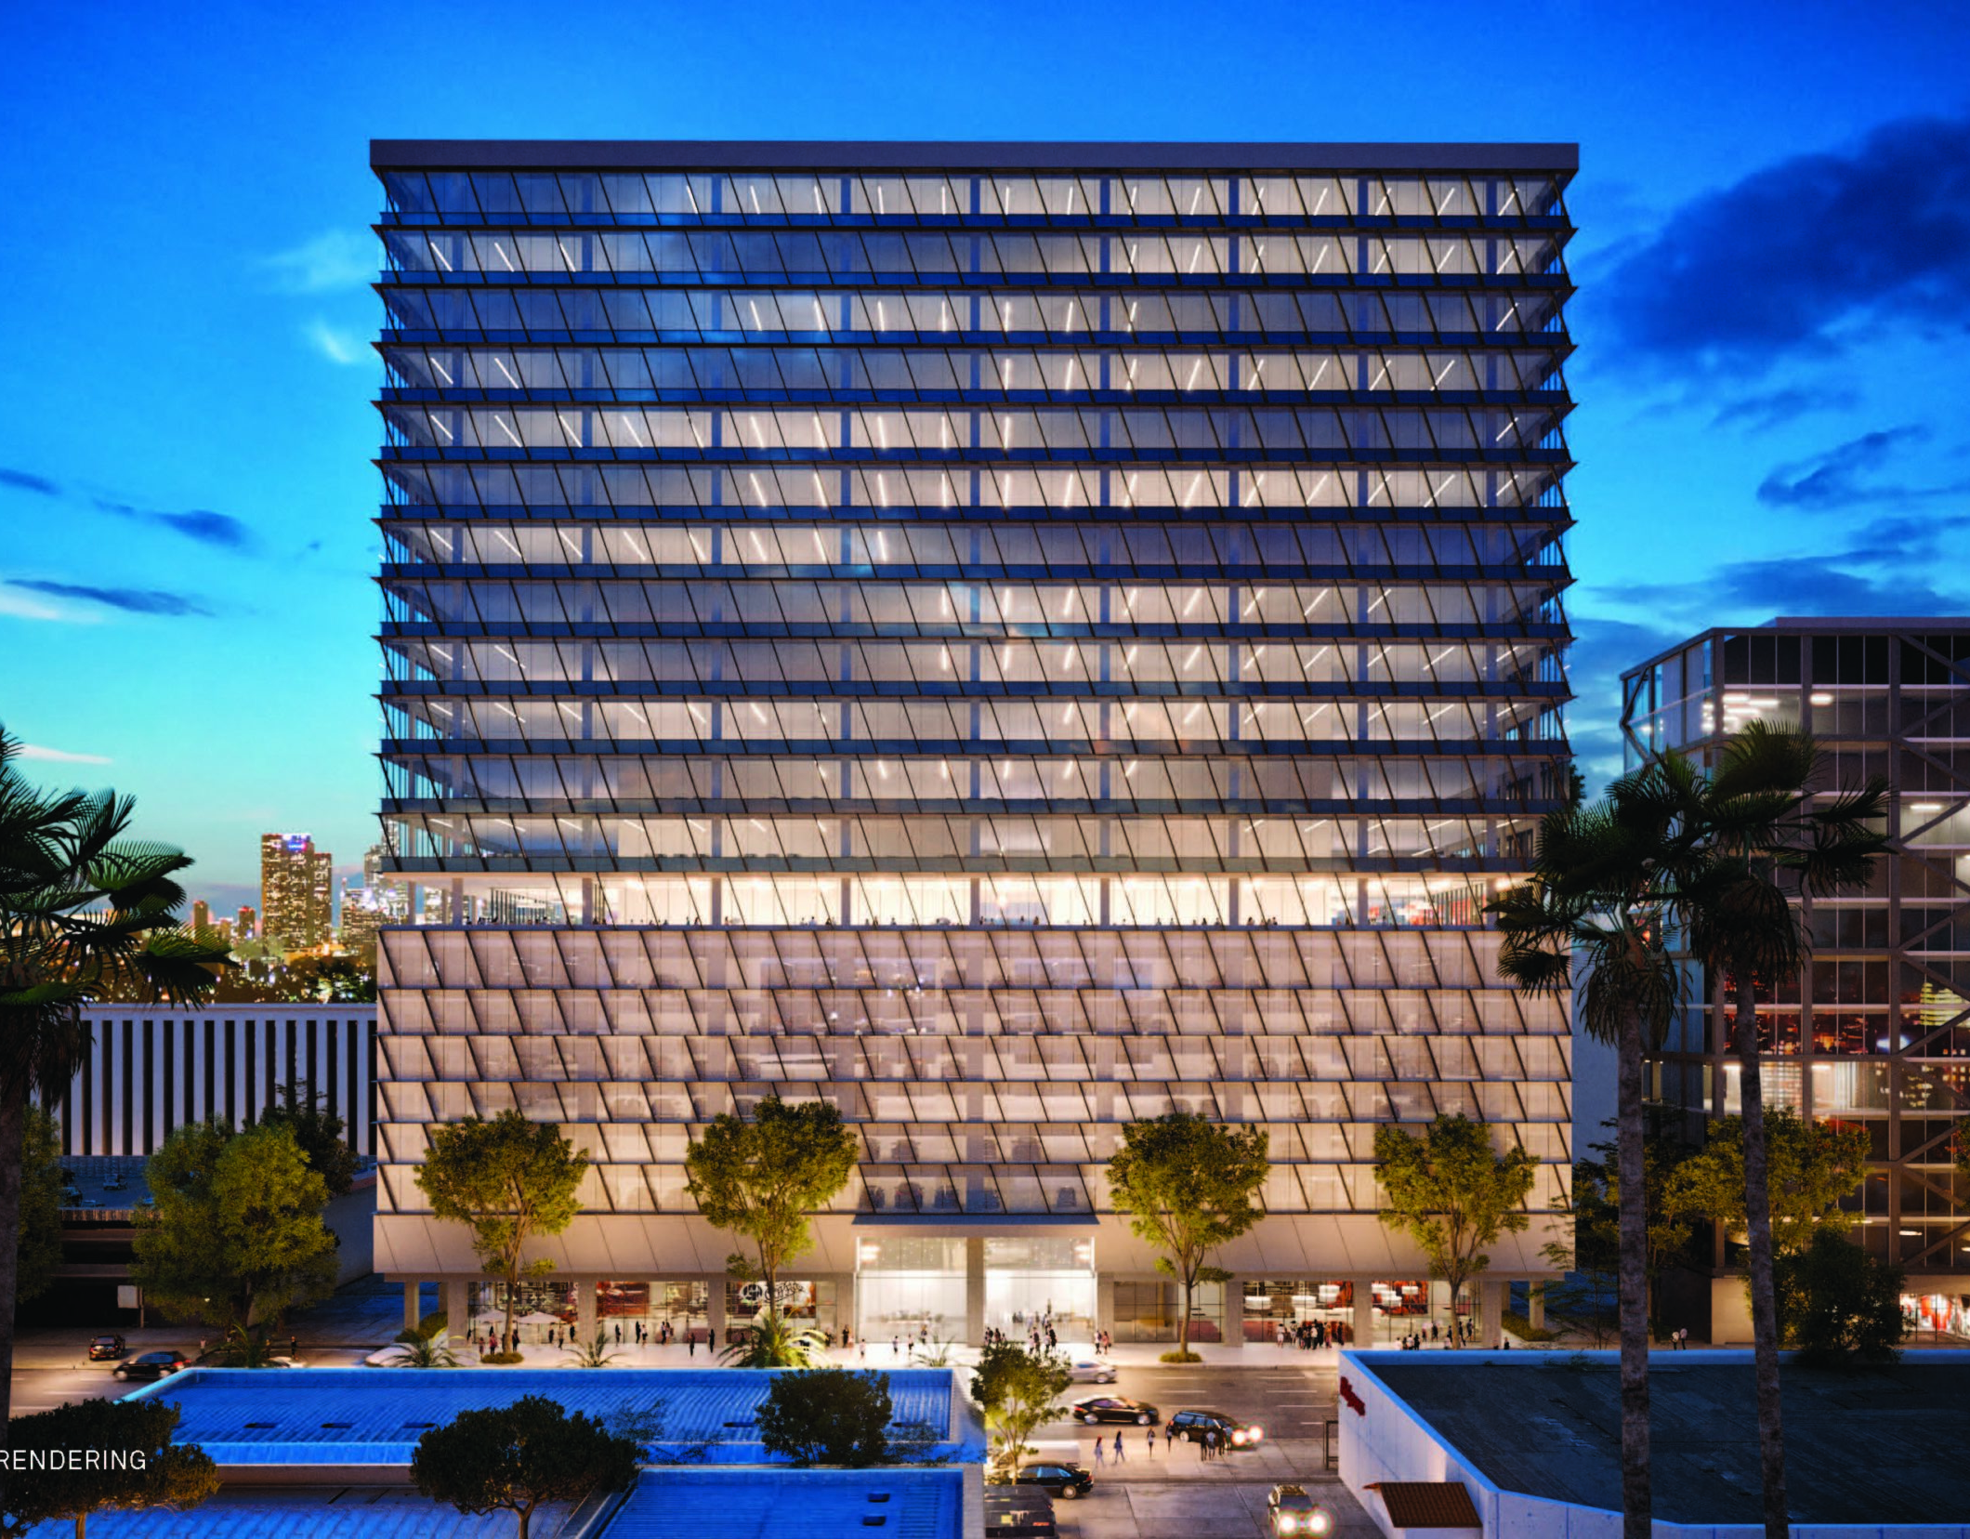
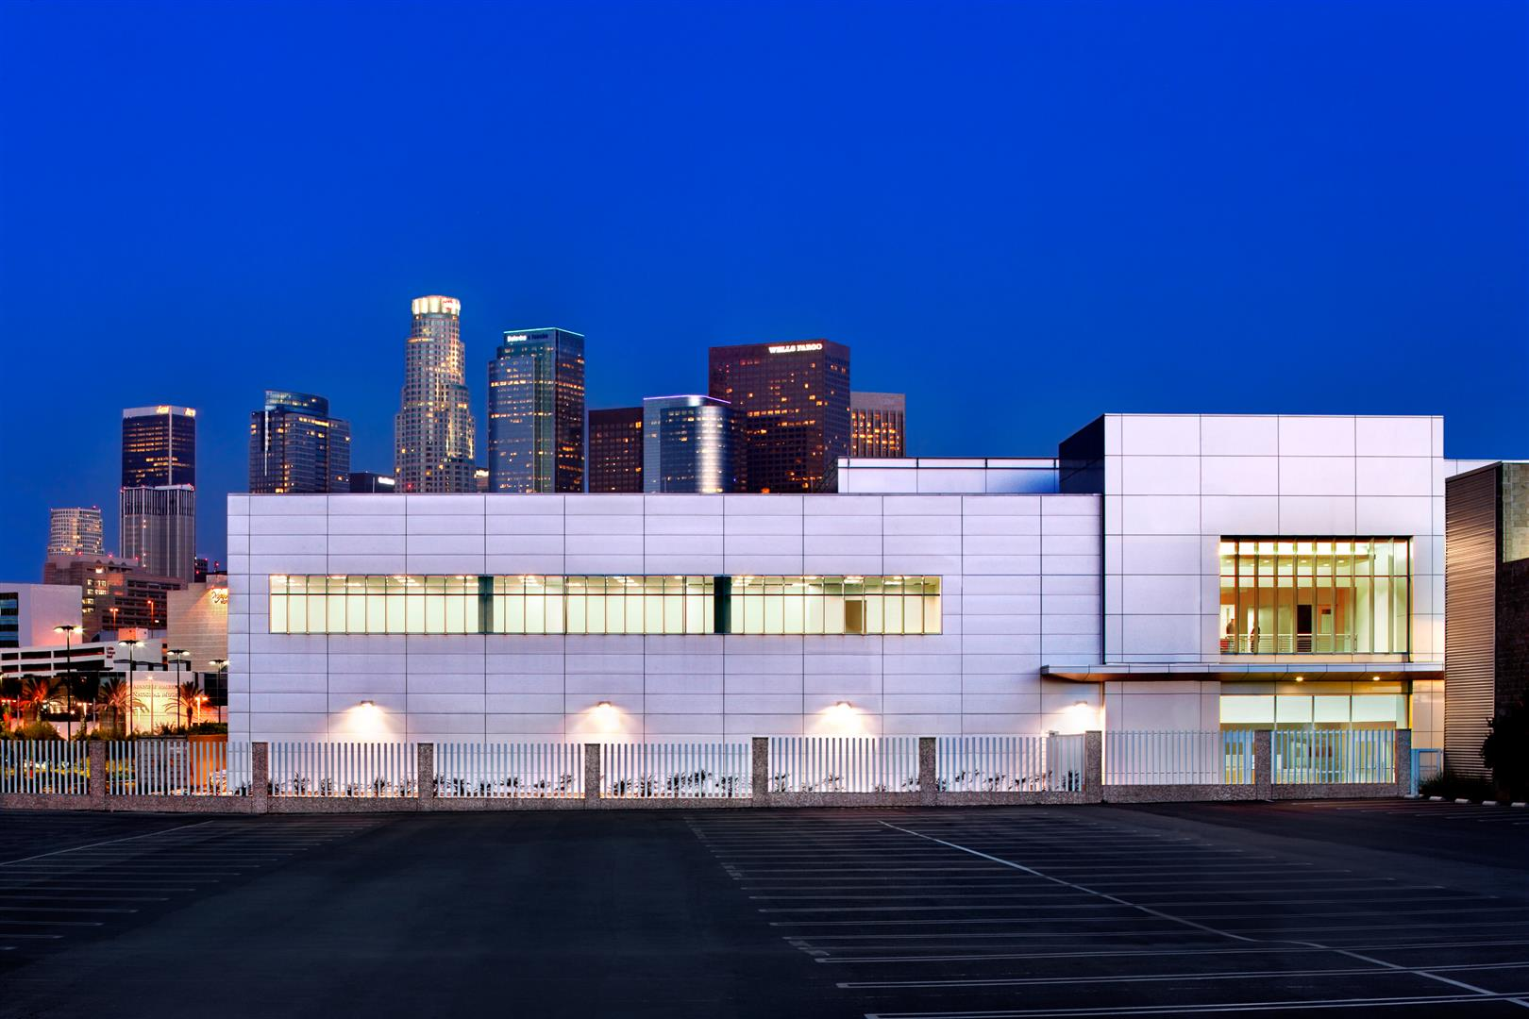
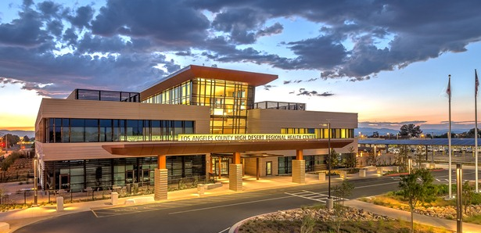
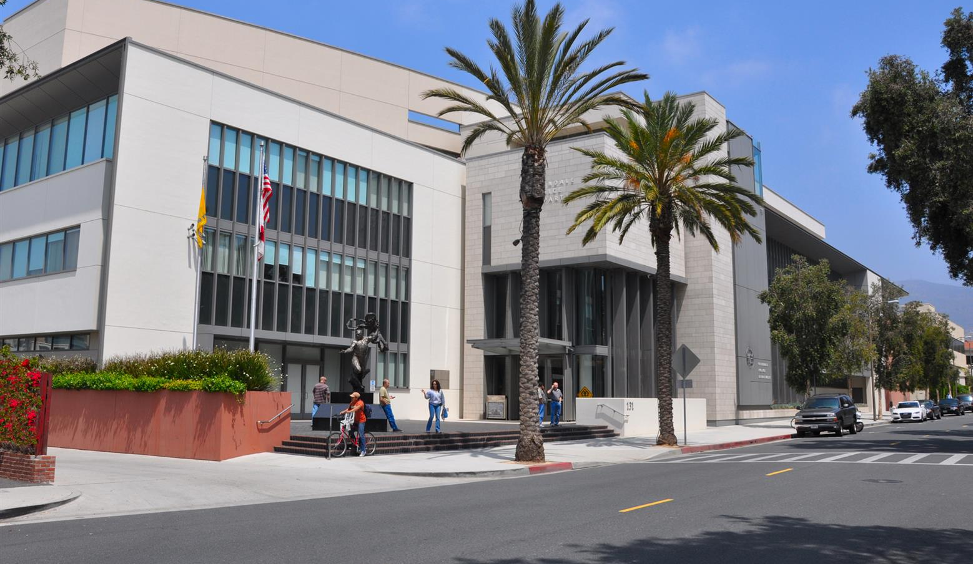
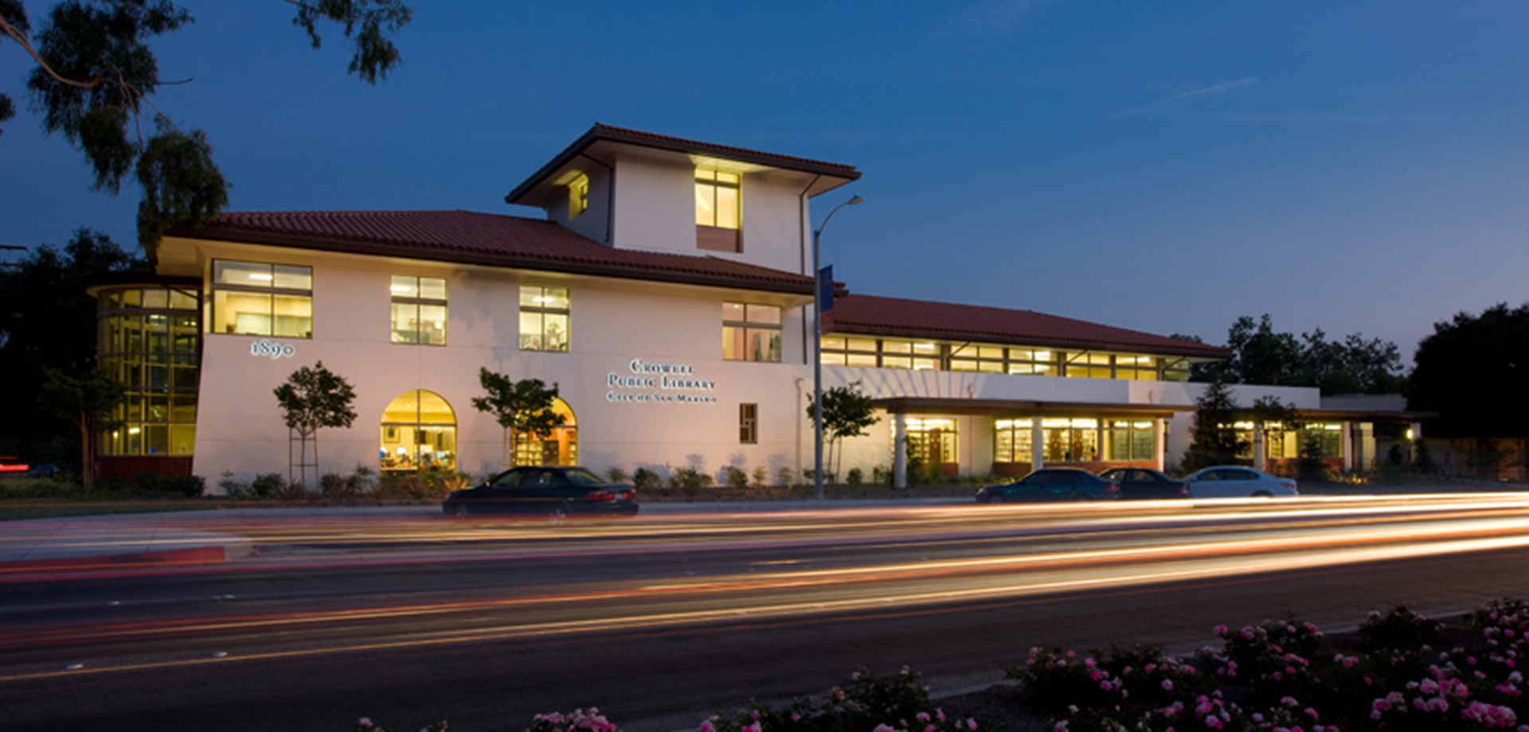
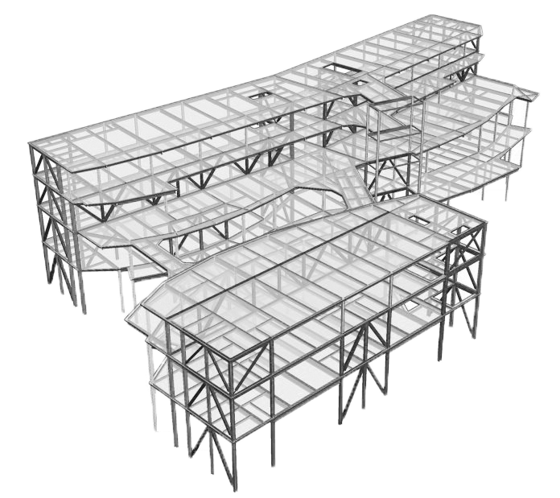
Civic experience

Slide 2
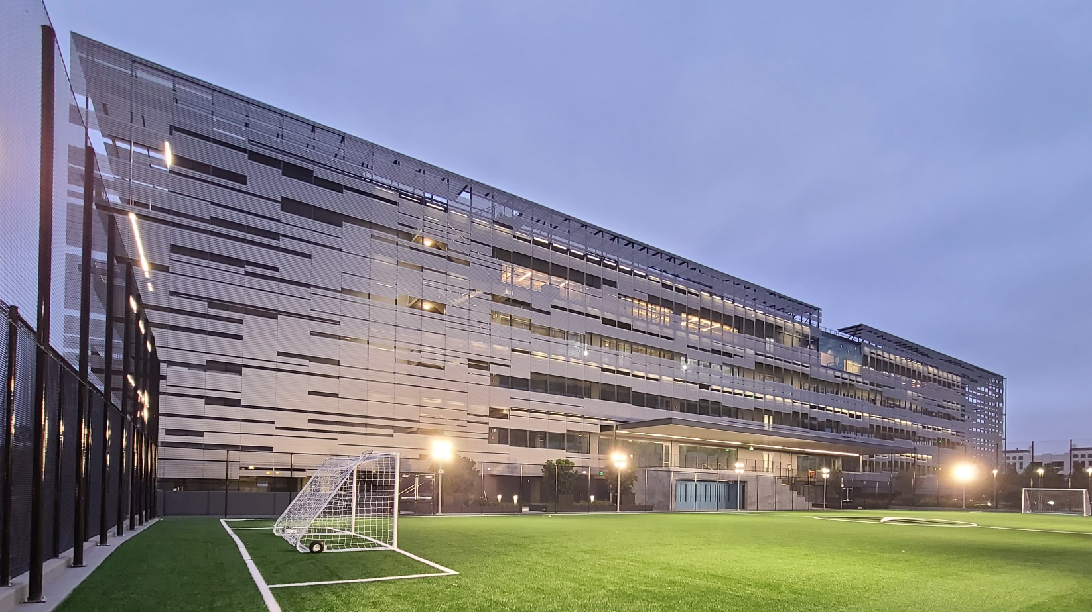
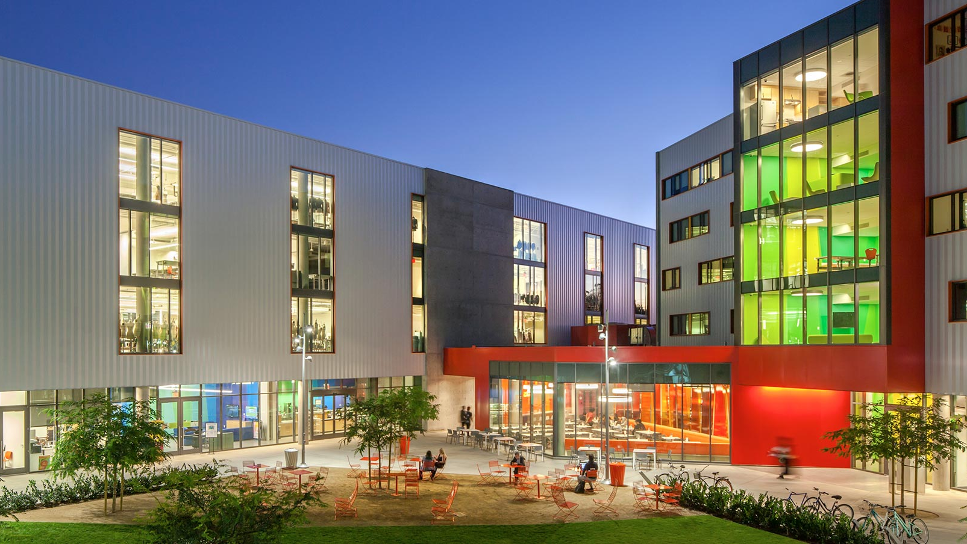
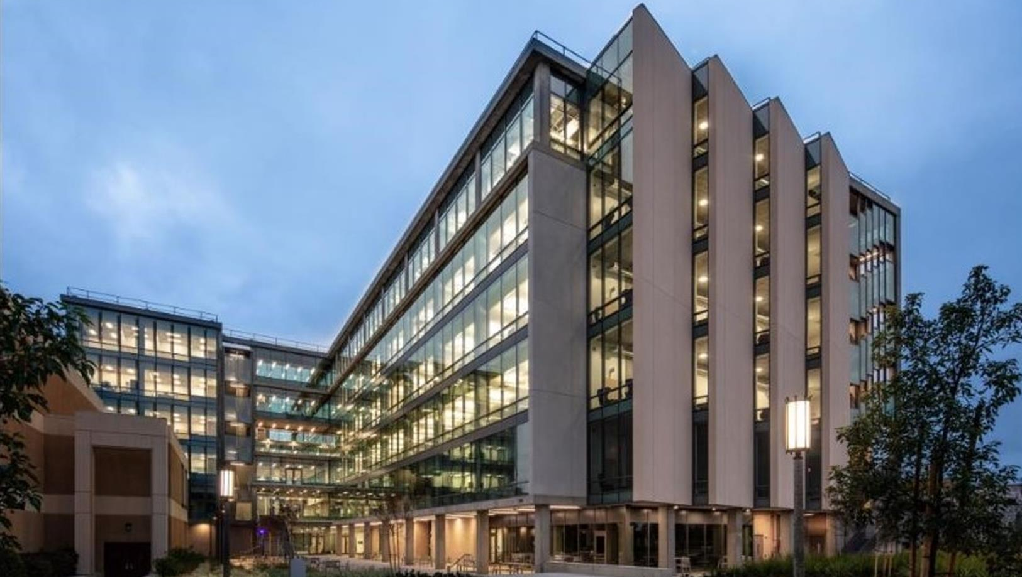
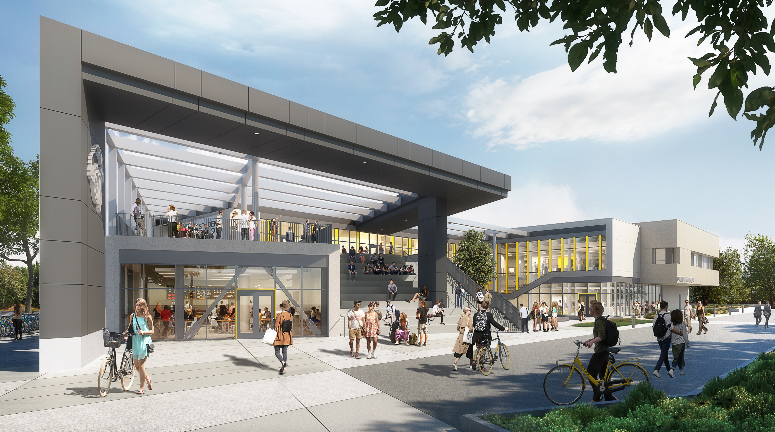
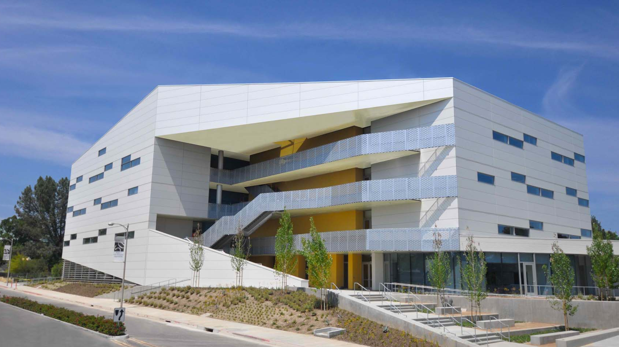
One of the Largest Structural Engineering Firms in Southern California
Years of Experience
(Founded in 1997
in Pasadena)
Staff of Engineering Professionals
24+
80+
26+
Design Excellence Awards in the Last 12 Years

Slide 3
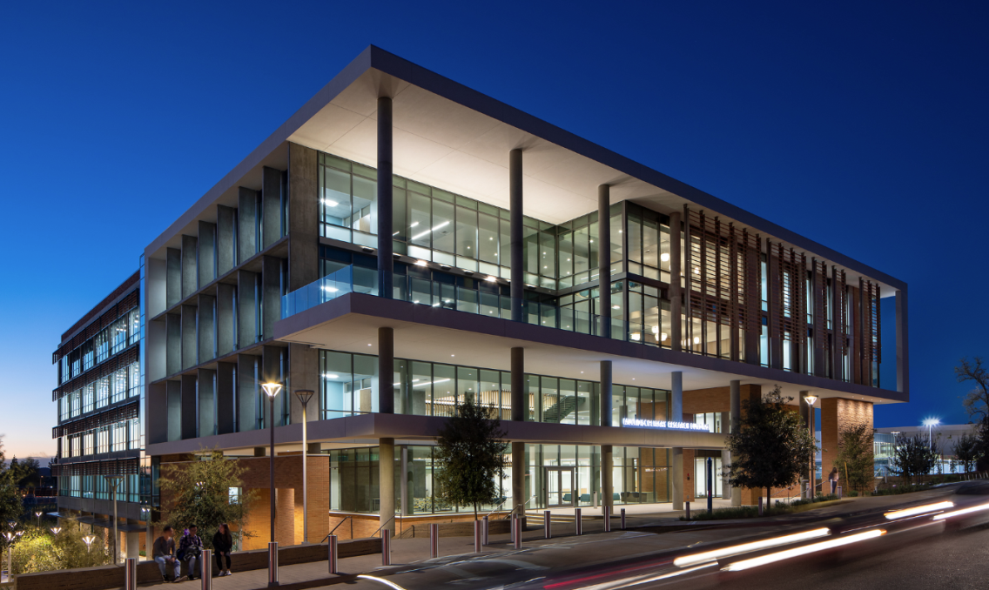
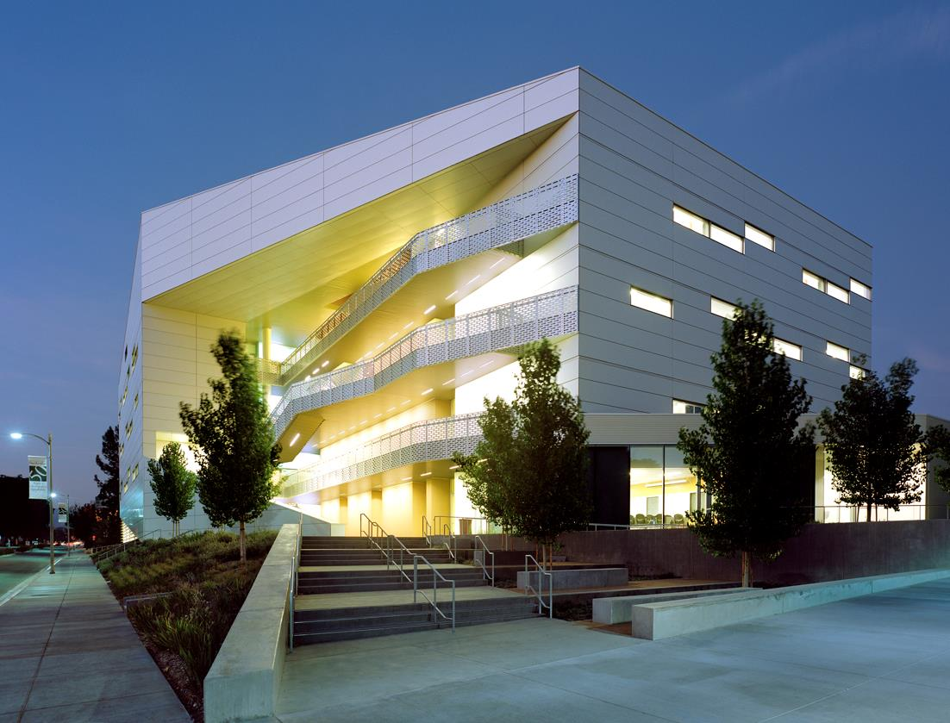
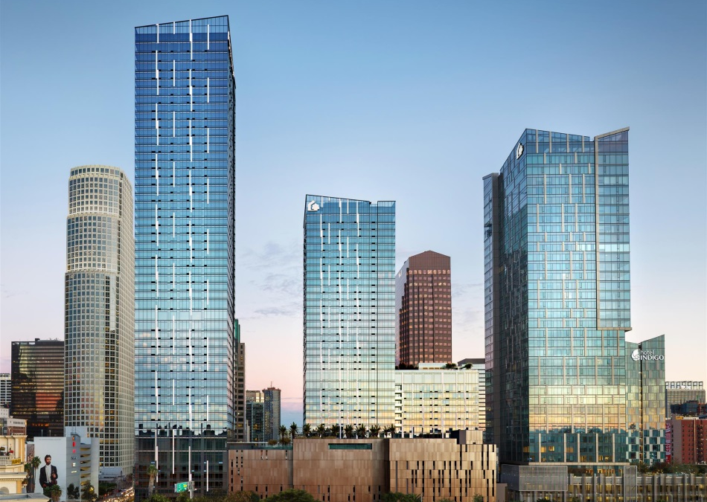
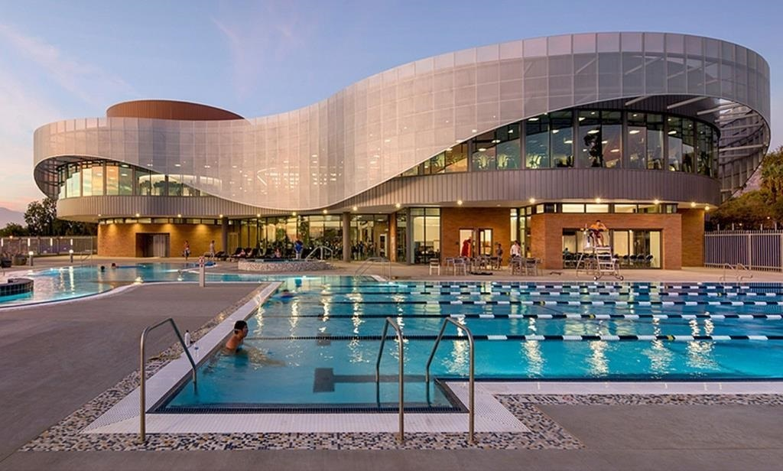
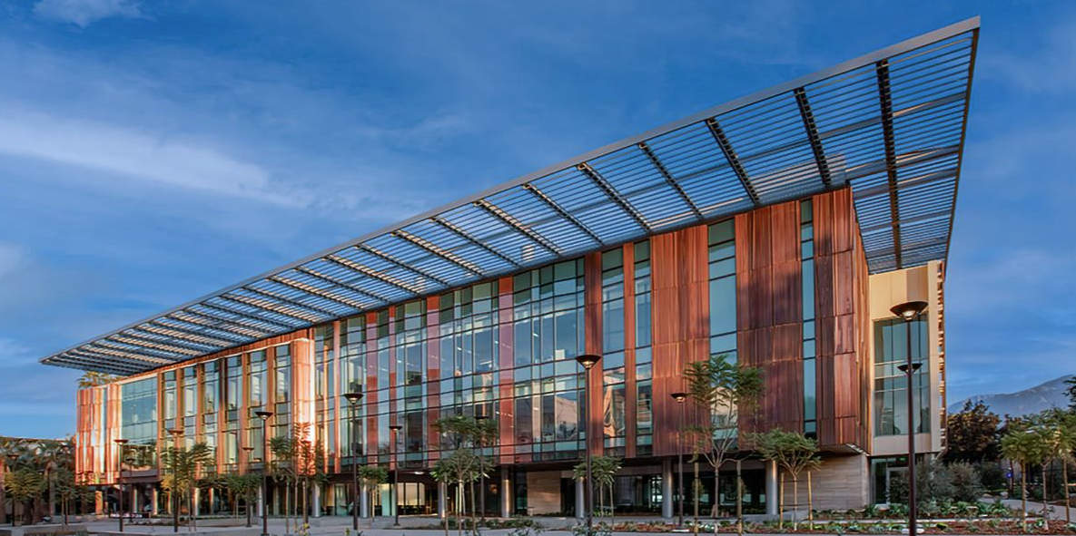
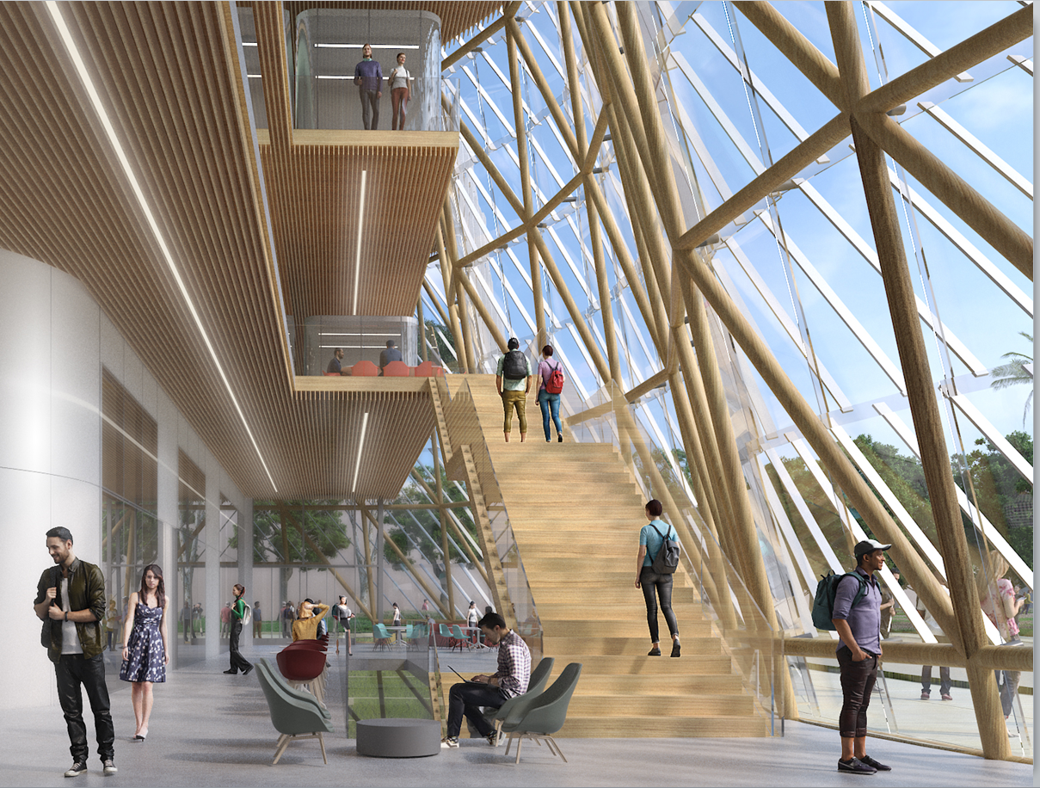
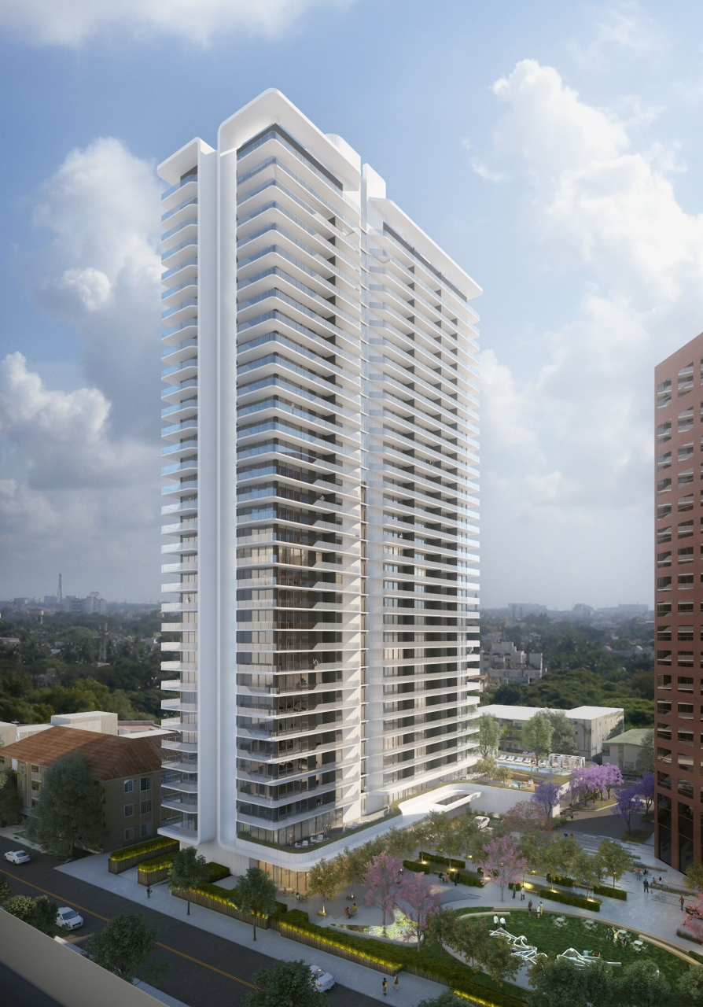
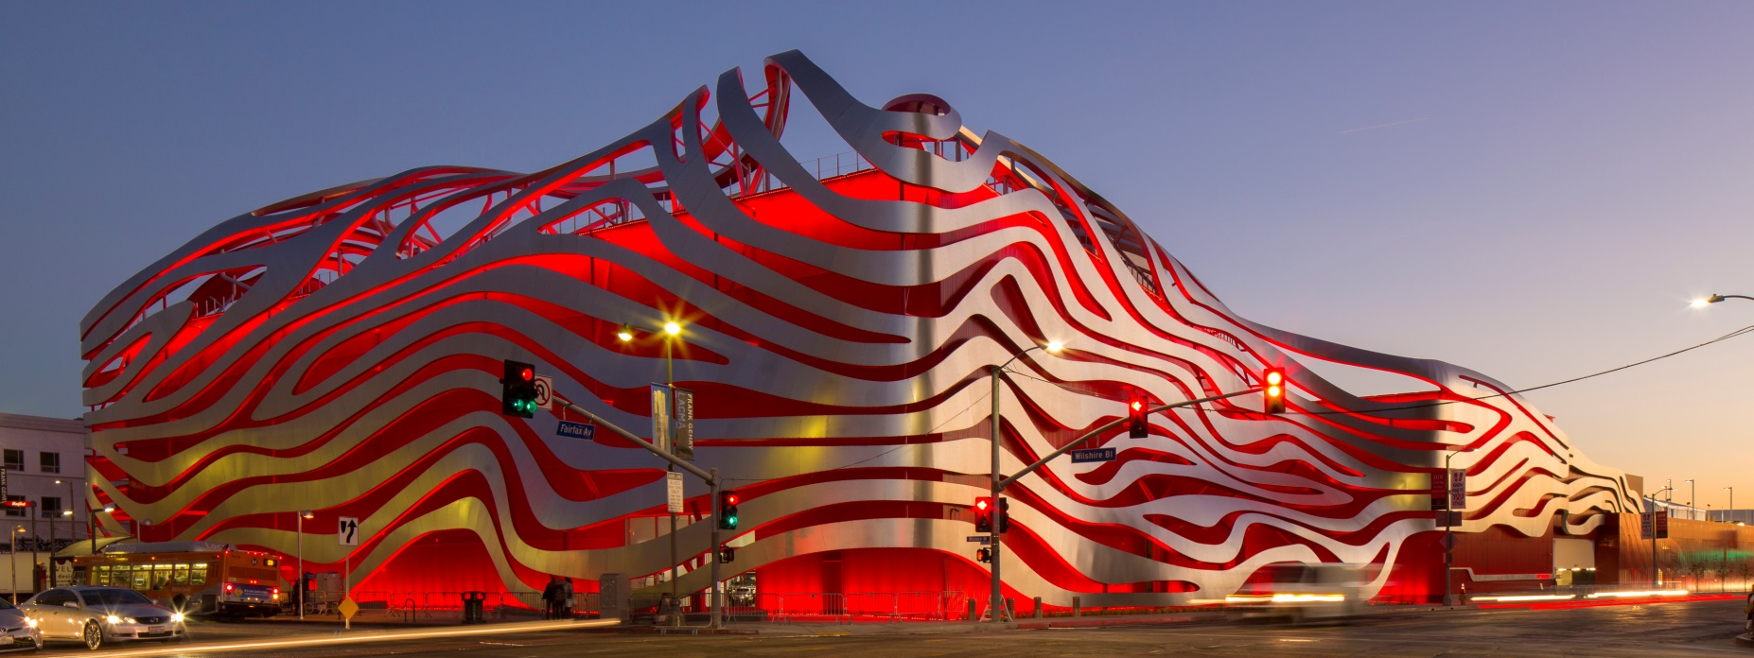
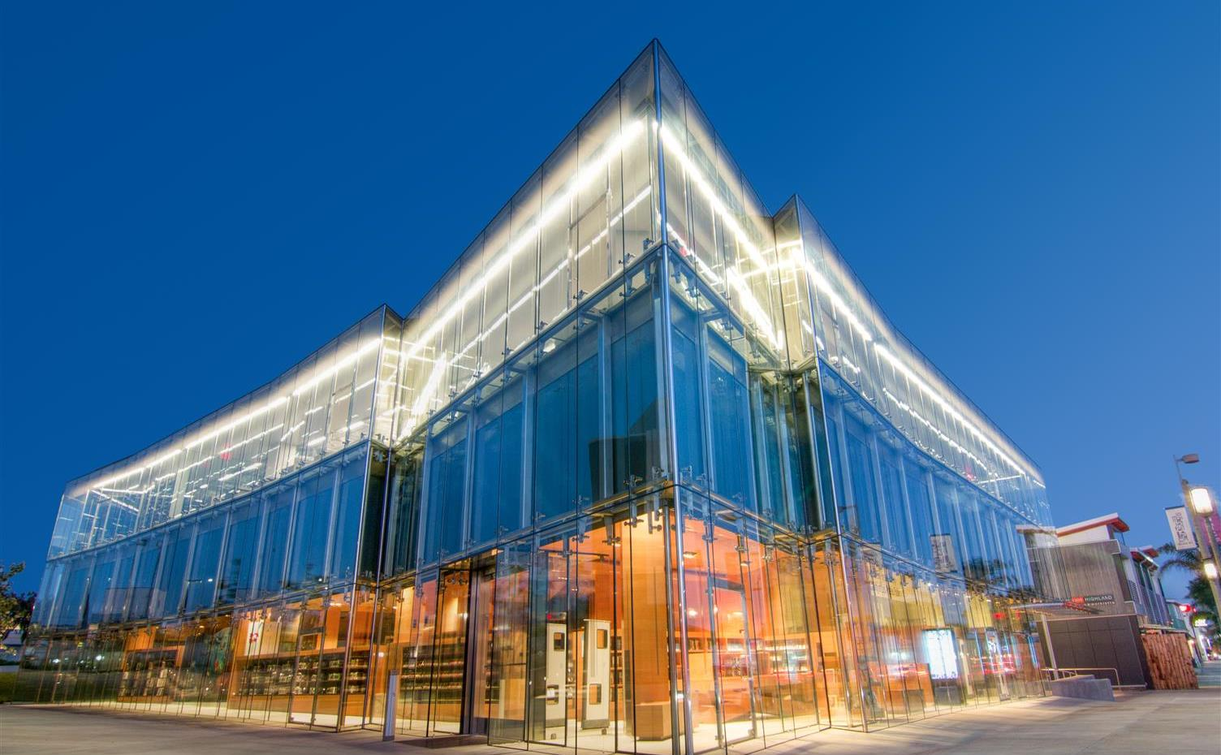
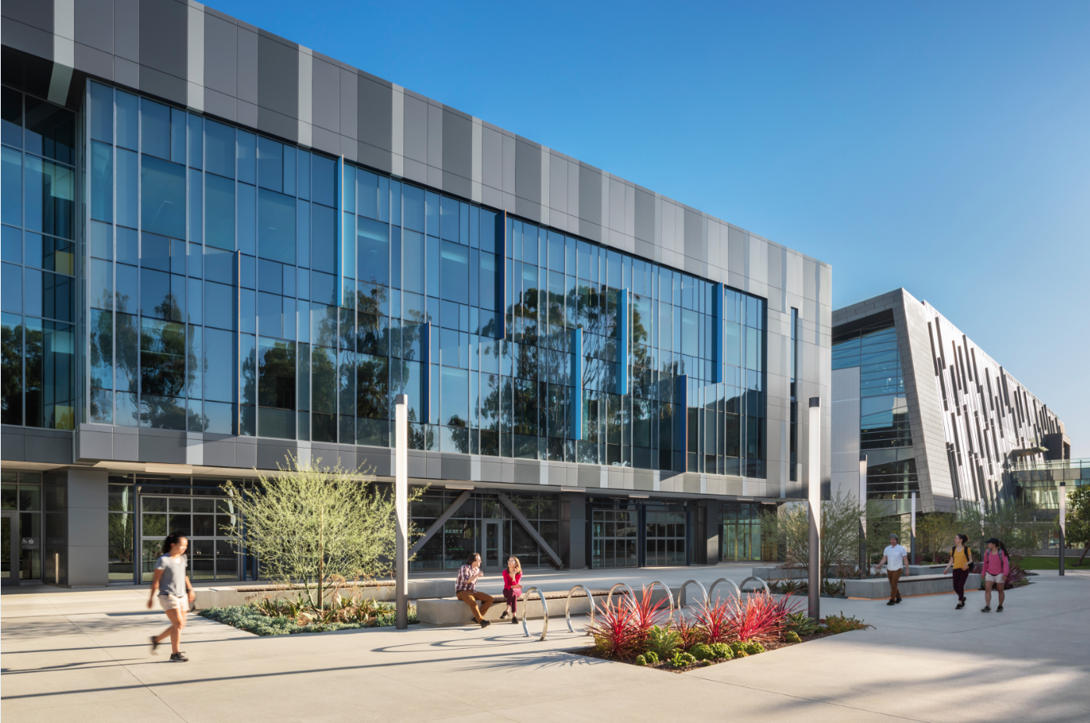
Saiful Bouquet | Diversified Practice
High-Rise
Hospitality / Mixed-Use
Residential
Higher Education
Community College / K-12
Healthcare
Life Science / Lab (S&T)
Retail / Entertainment
Aviation
International
Commercial Office
Design-Build / IPD
Civic / Justice

Slide 4
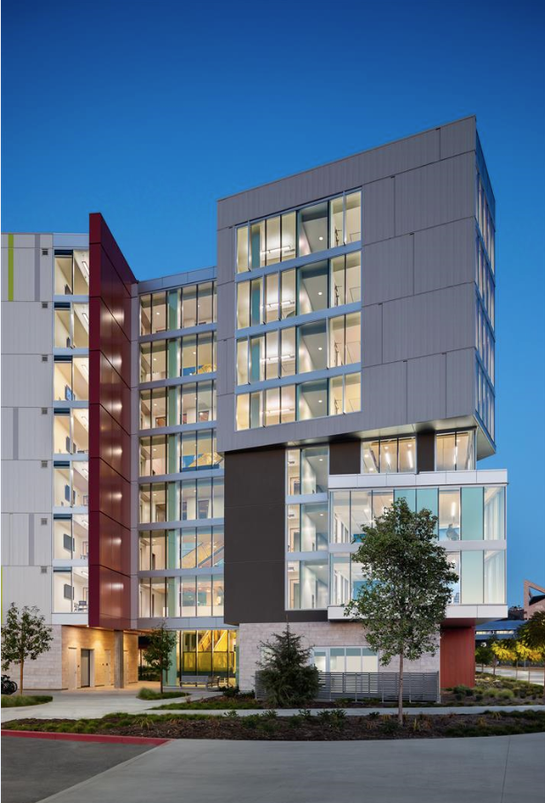
Saiful Bouquet | Our Approach
Set the Project Right Early!
Expeditor & Advocate of the Project
Holistic Approach to the Project
Pro-Active not Reactive
Collaborative/Team Approach to the Project
Creative but Practical
Cost-Effective Design!

Slide 5
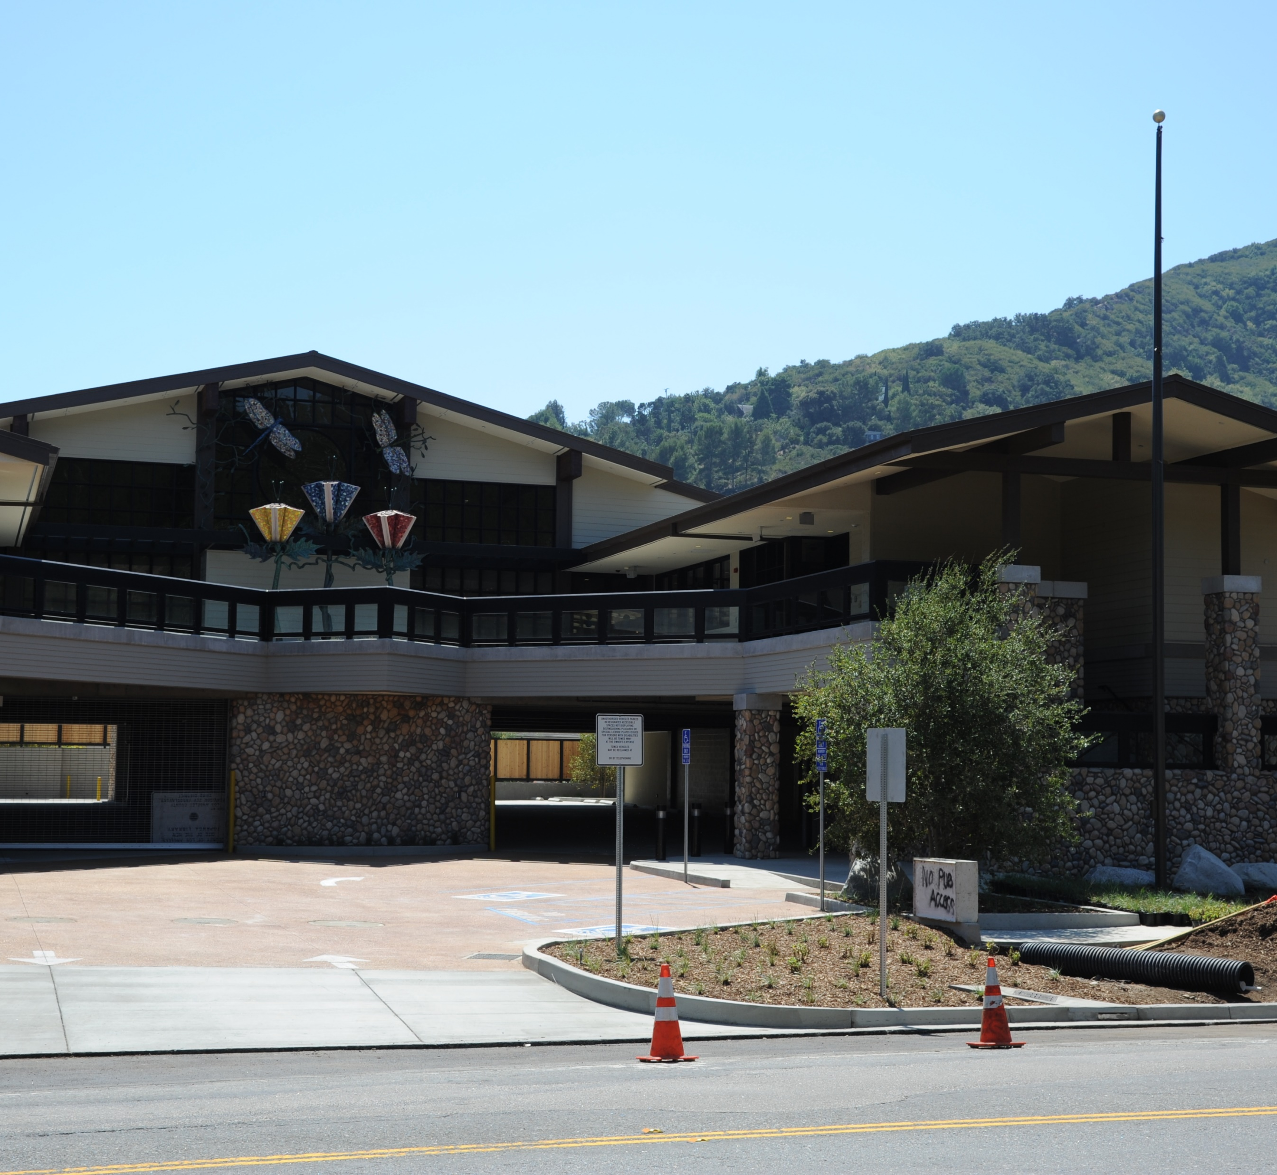
Testimonial
Topanga Public Library
“
Your firm is always an asset to us on any project you do!”
David Howard, Assistant Deputy Director LA County Dept. of Public Works

Slide 6
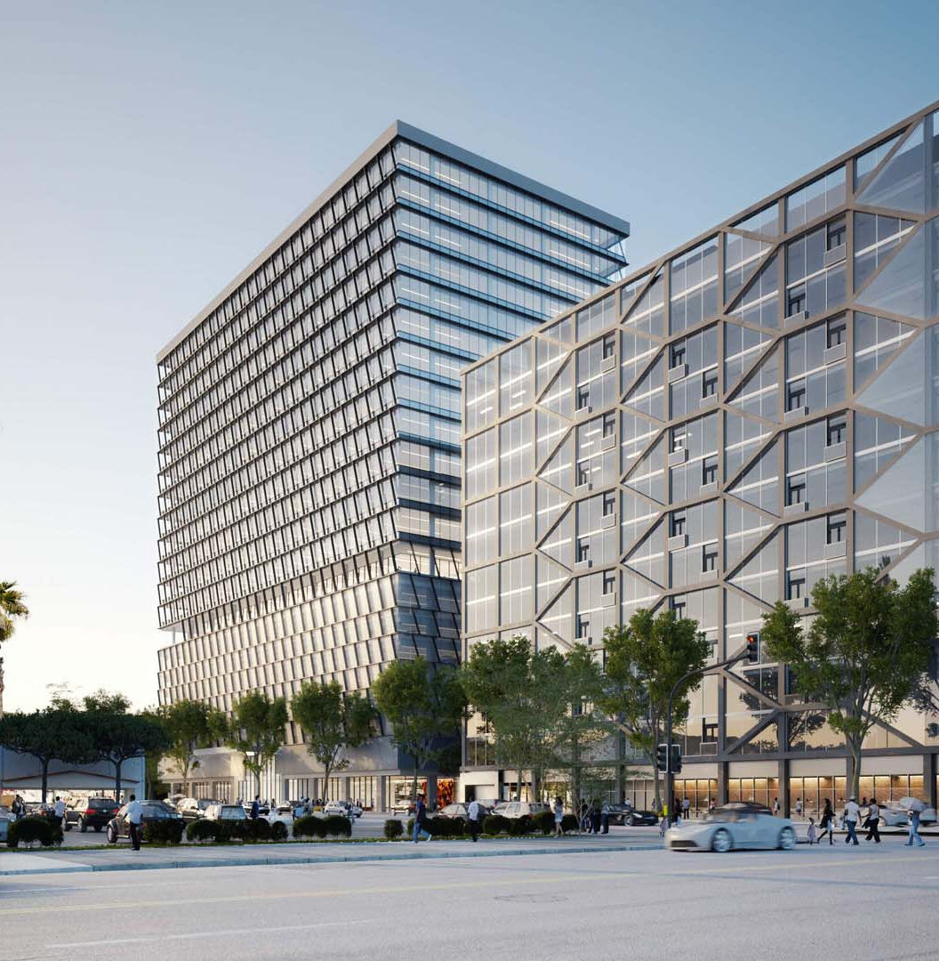
Testimonial
LA County Projects
“
…I would highly encourage you to participate in future design-build work with the County because your firm (and especially you) work very collaboratively with project teams to develop innovative solutions to structural problems.”
Andrew Moey, Capital Projects Program Manager LA County Dept. of Public Works

Slide 7
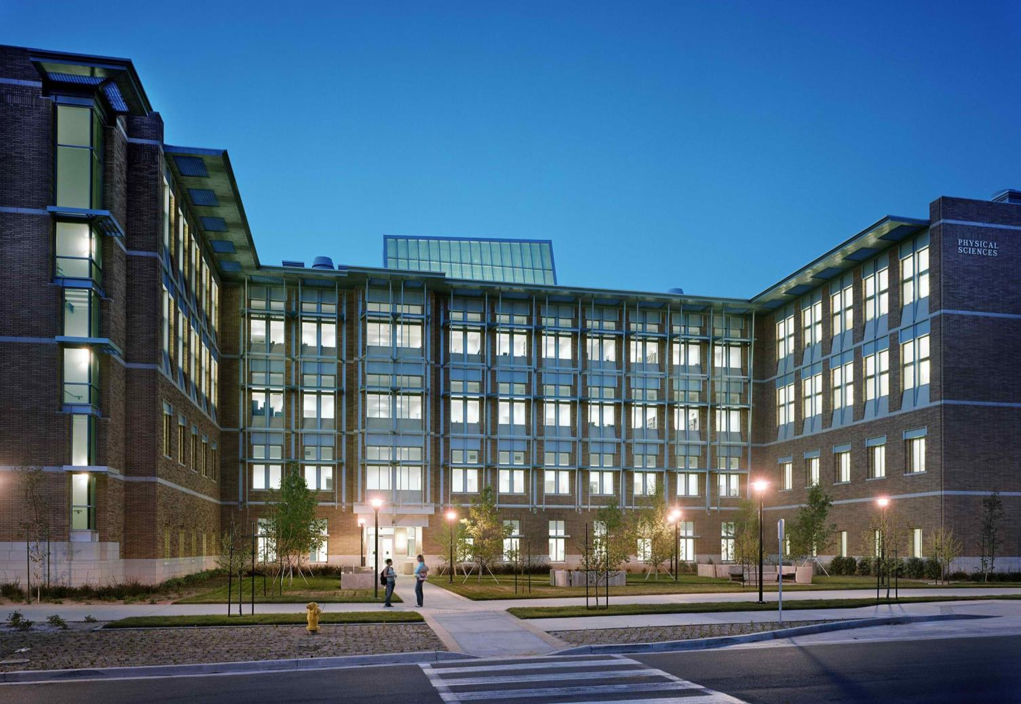
Testimonial
Martin Luther King
Inpatient Expansion
“
Your firm is always an asset to us on any project that you do!”
Dave Howard, Assistant Deputy Director LA County Dept. of Public Works

Slide 8
Select
Civic

Slide 9
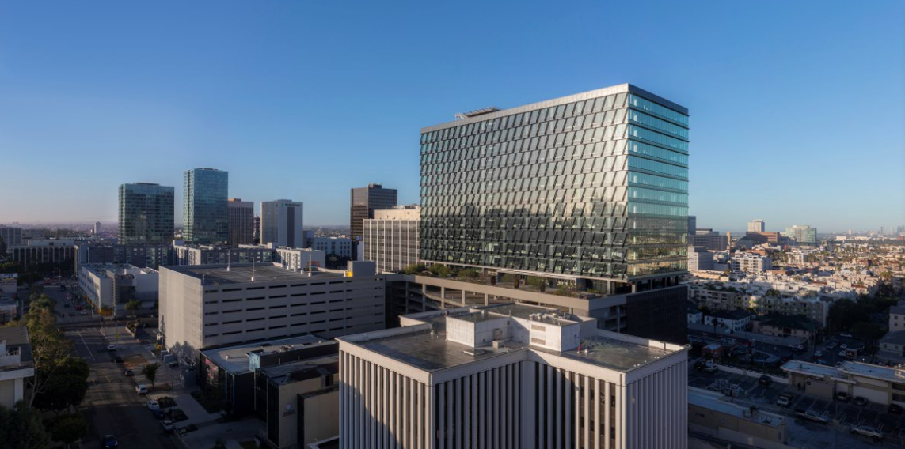
La Department of Mental Health Los Angeles, CA
Gensler

Slide 10
Los Angeles Emergency Operations Center Los Angeles, CA
Fluor | HOK

Slide 11
LEED SILVER CERTIFIED
High Desert Multi-Service Ambulatory Care Center (MACC) Lancaster, CA
LBL Architects

Slide 12
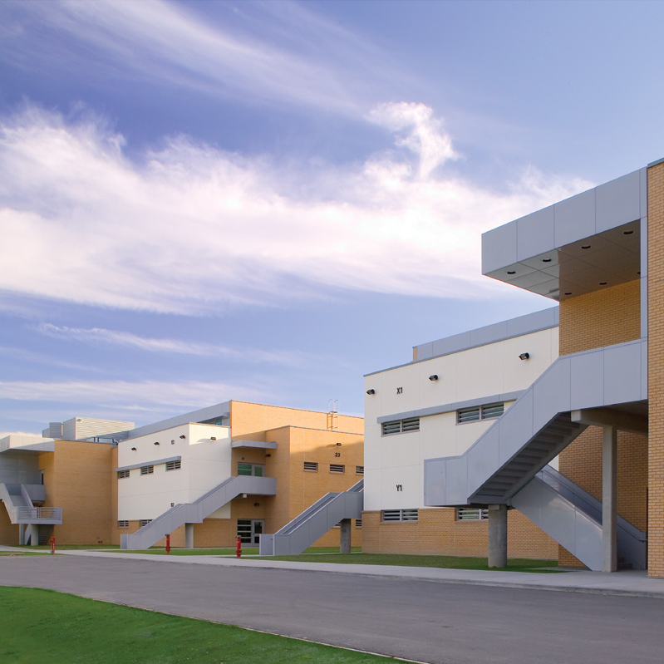
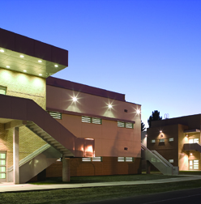
Los Padrinos Juvenile Detention Center Los Angeles, CA
Design-Build: Turner Construction Company | gkkworks

Slide 13
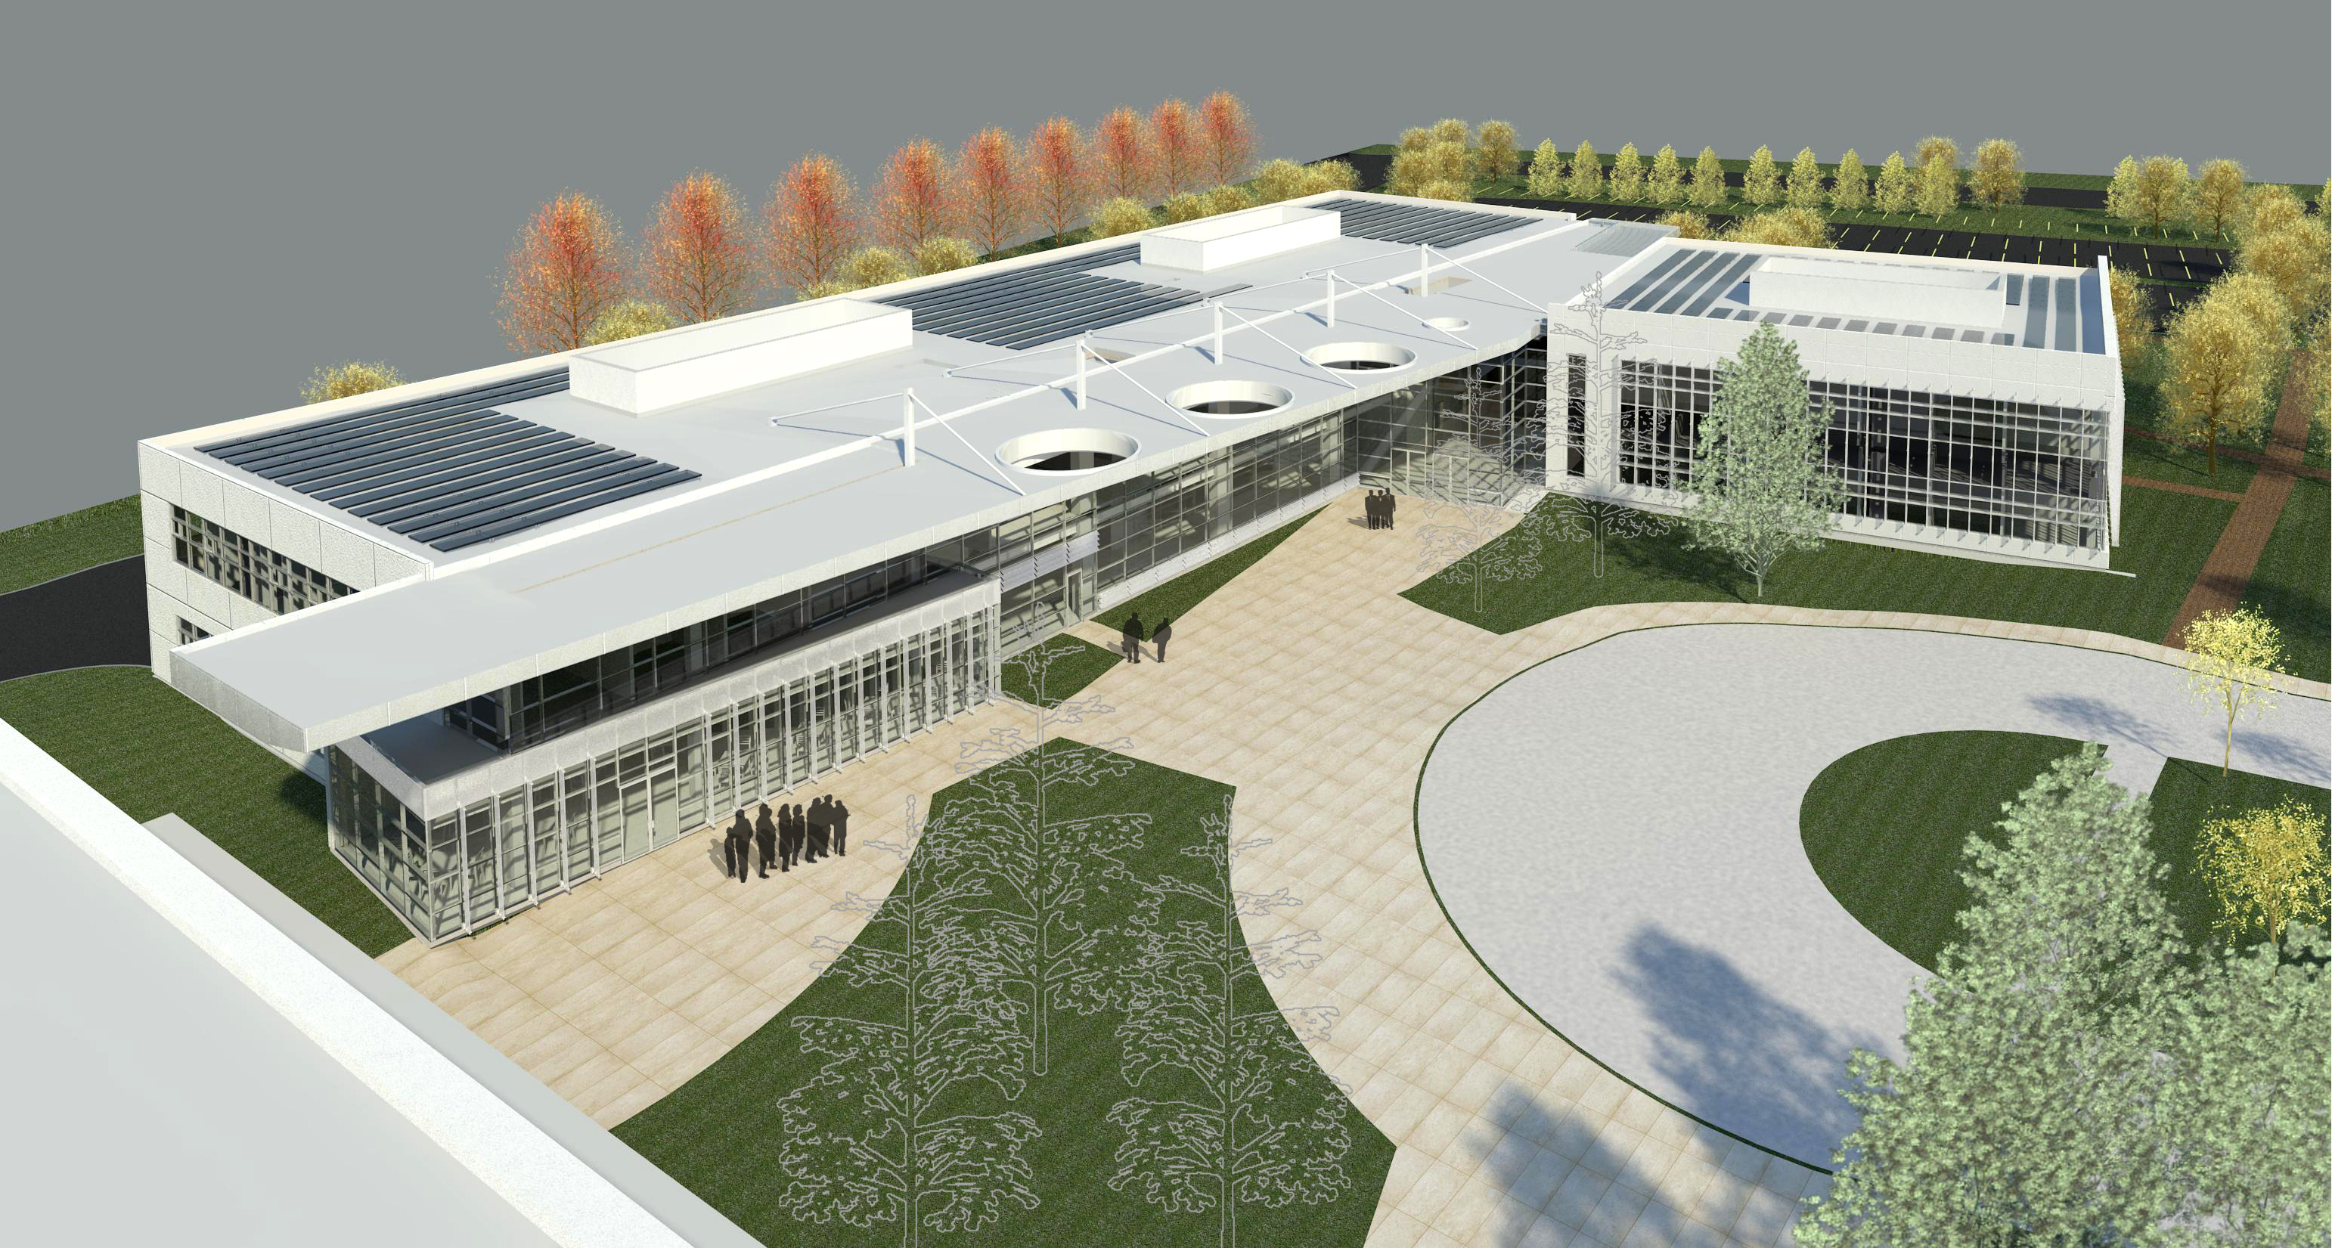
LEED SILVER CERTIFICATION
Juvenile Justice Center Oxnard, CA
KMD Architects

Slide 14
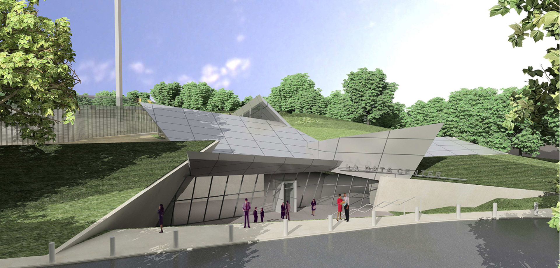
Countywide Data Center Los Angeles, CA
Gensler

Slide 15
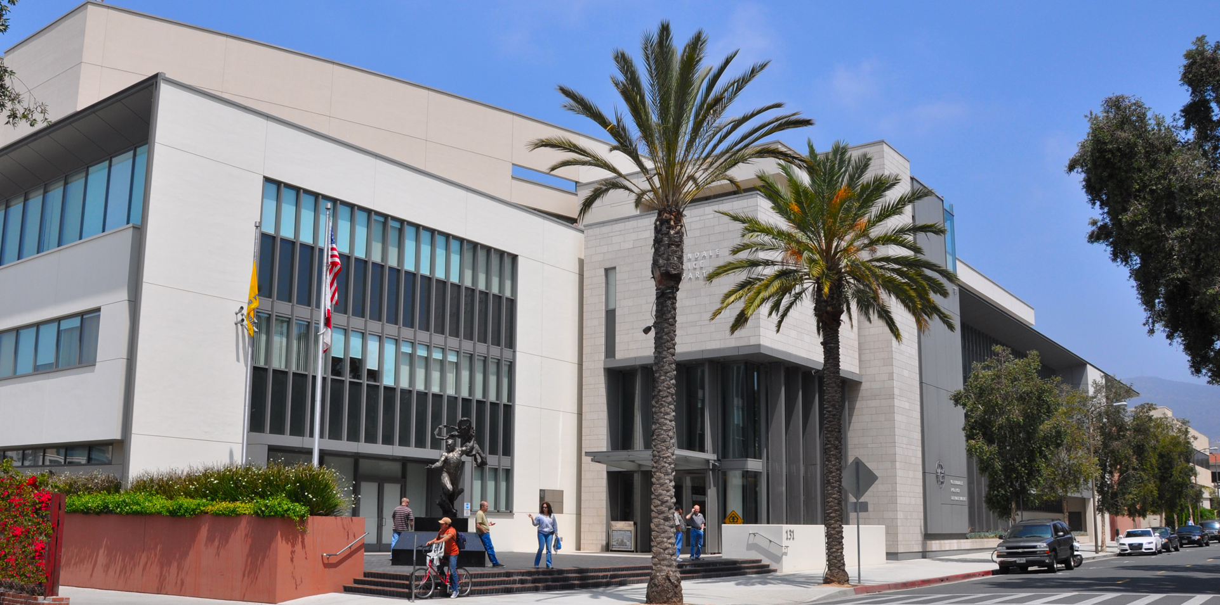
Glendale Police Station & Jail Facility Glendale, CA
Cannon Design

Slide 16
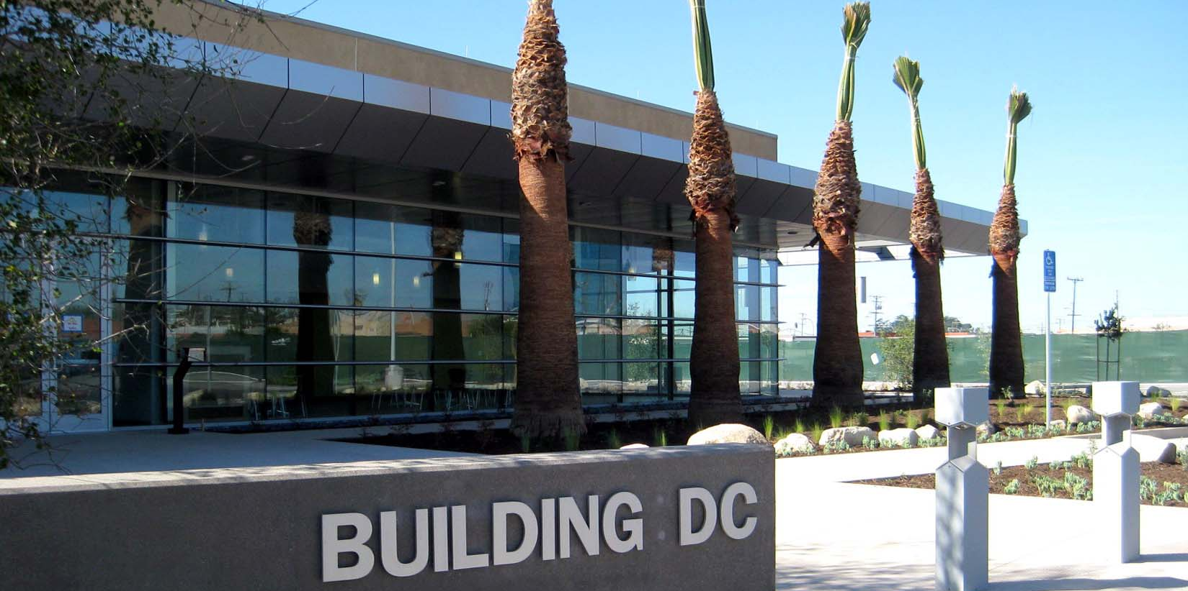
Southern California Edison Data Center Alhambra, CA
Design-Build: Turner Construction | Callison

Slide 17
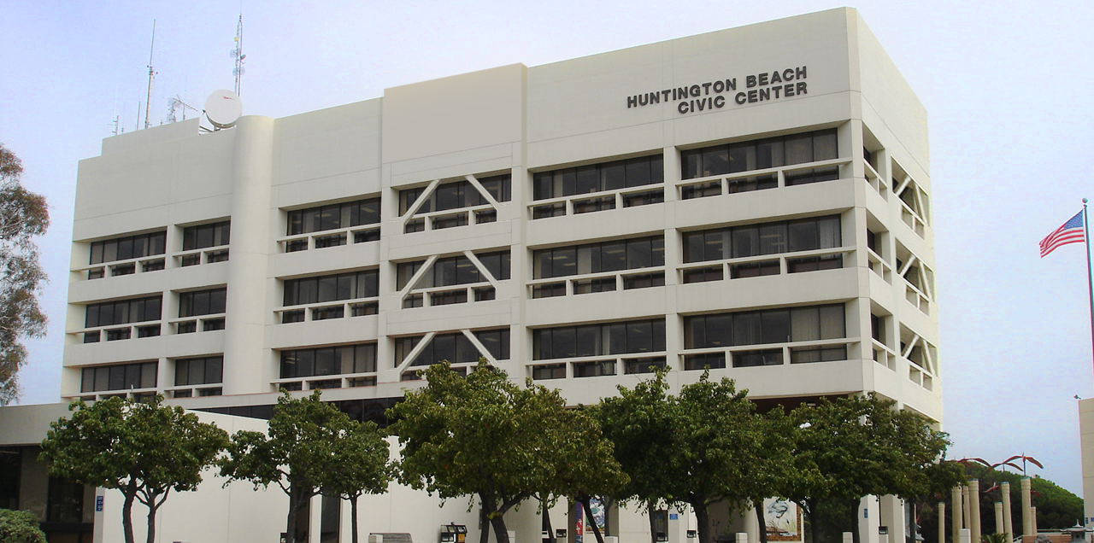
Huntington Beach City Hall Huntington Beach, CA
LHA

Slide 18
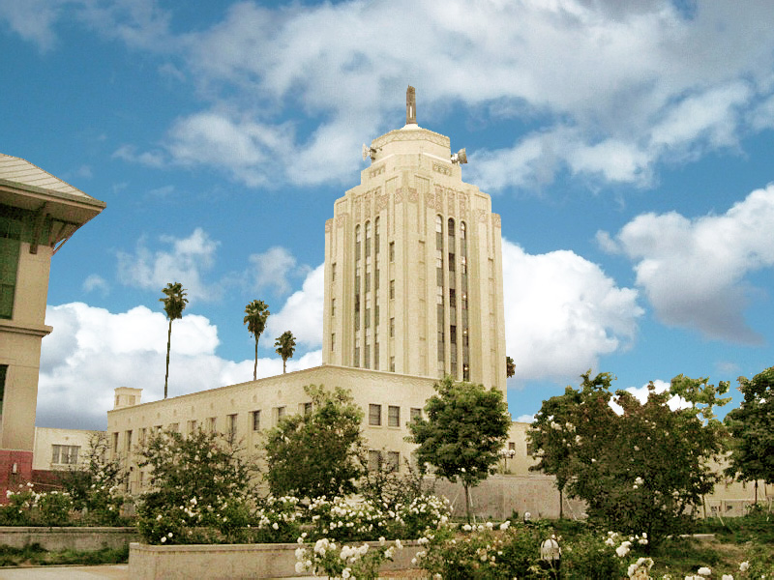
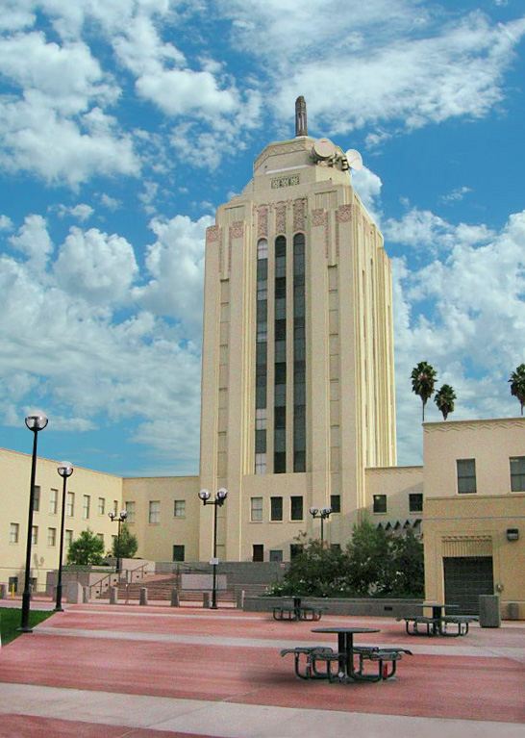
LEED PLATINUM CERTIFIED
2006 LOS ANGELES CONSERVANCY PRESERVATION AWARD
Van Nuys City Hall Van Nuys, CA
Tetra-IBI Group & Kennard Design Group

Slide 19
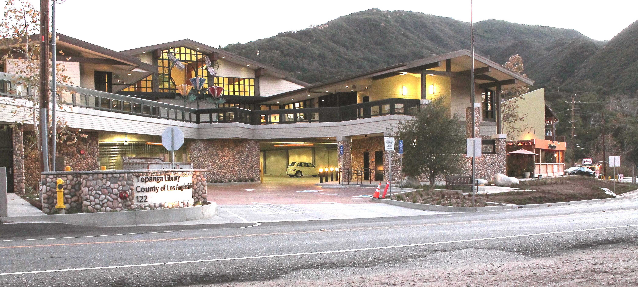
LEED GOLD CERTIFIED
Topanga Library Topanga, CA
gkkworks

Slide 20
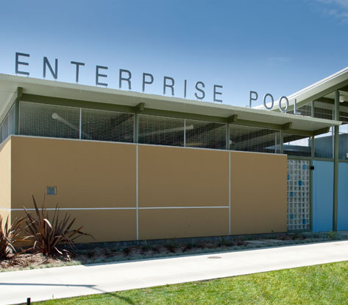
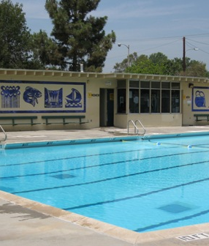
Enterprise Park Pool Los Angeles, CA
Frank R. Webb Architects

Slide 21
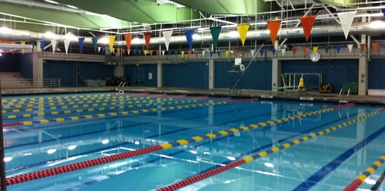
Echo Park Recreation Facility Los Angeles, CA
Frank Webb Architects

Slide 22
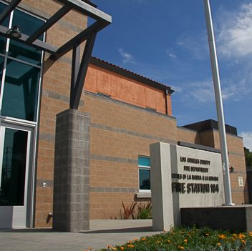
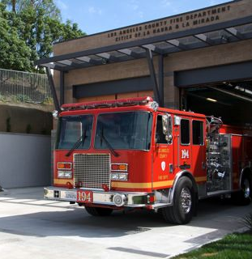
LEED SILVER CERTIFIED
Los Angeles County Fire Station No. 194 La Habra, CA
William Loyd Jones Architect

Slide 23
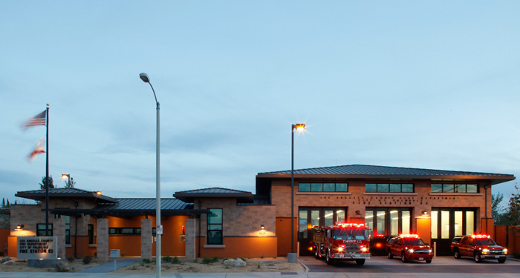
LEED SILVER CERTIFIED
Los Angeles County Fire Station No. 93 Palmdale, CA
William Loyd Jones Architect

Slide 24
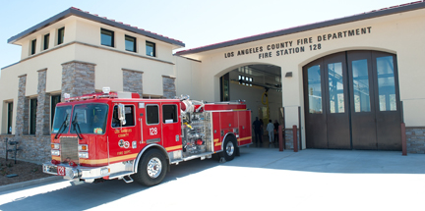
Los Angeles County Fire Station No. 128 Canyon Country, CA
William Loyd Jones Architect

Slide 25
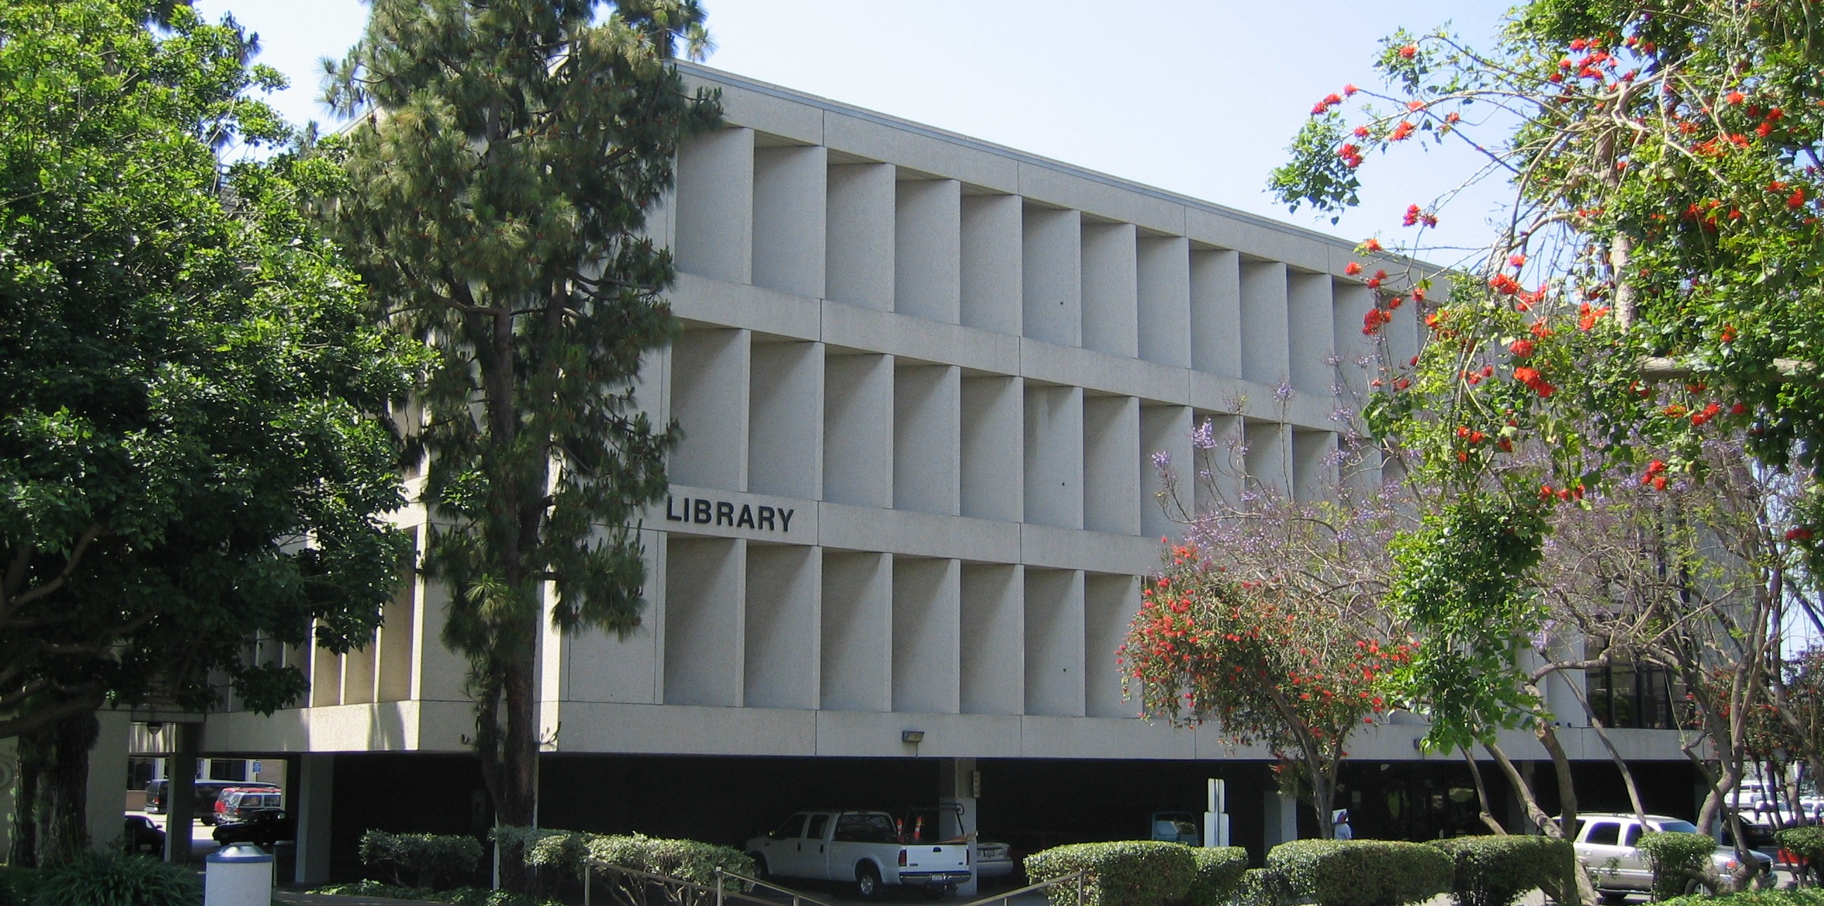
Inglewood Main Library Inglewood, CA

Slide 26
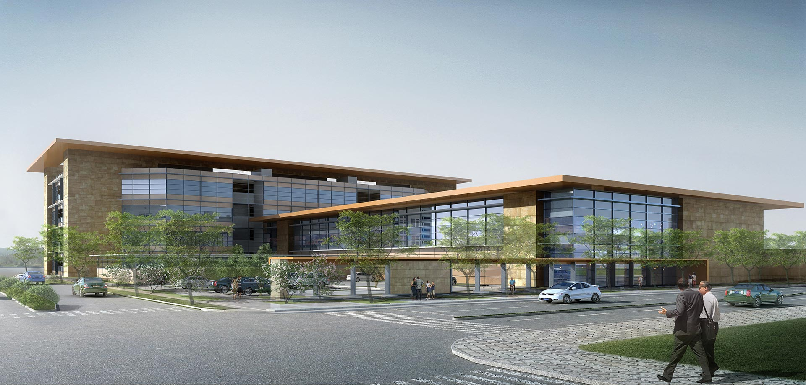
East County Replacement Detention Center Riverside, CA
HOK Architects

Slide 27
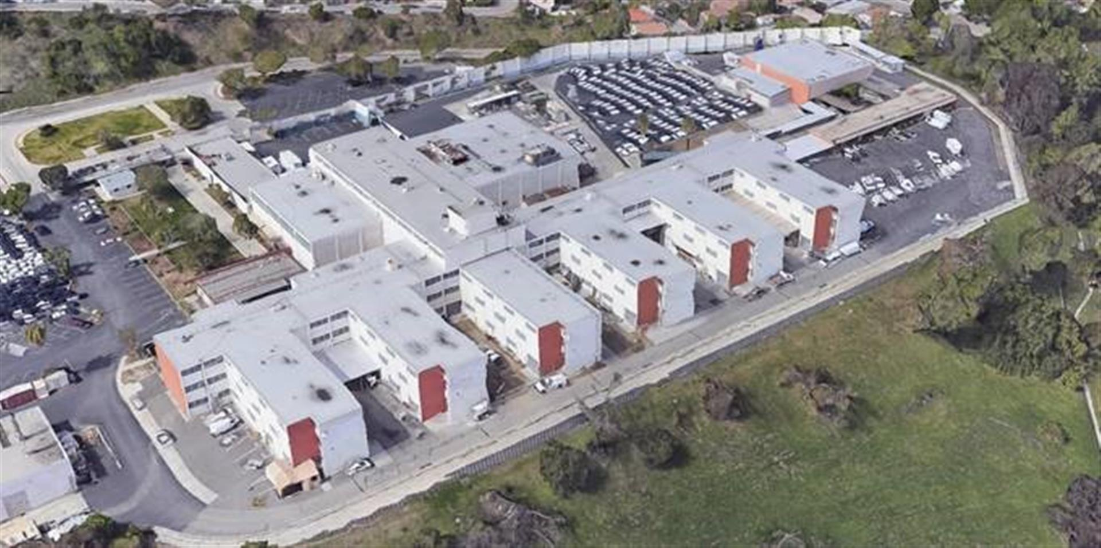
Sybil Brand Institute Monterey Park, CA
DMJM H&N

Slide 28
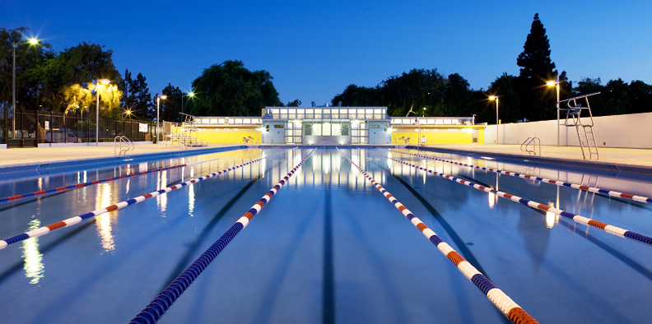
Ted Watkins Enterprise Park Pool Los Angeles, CA
Frank Wedd Architects

Slide 29
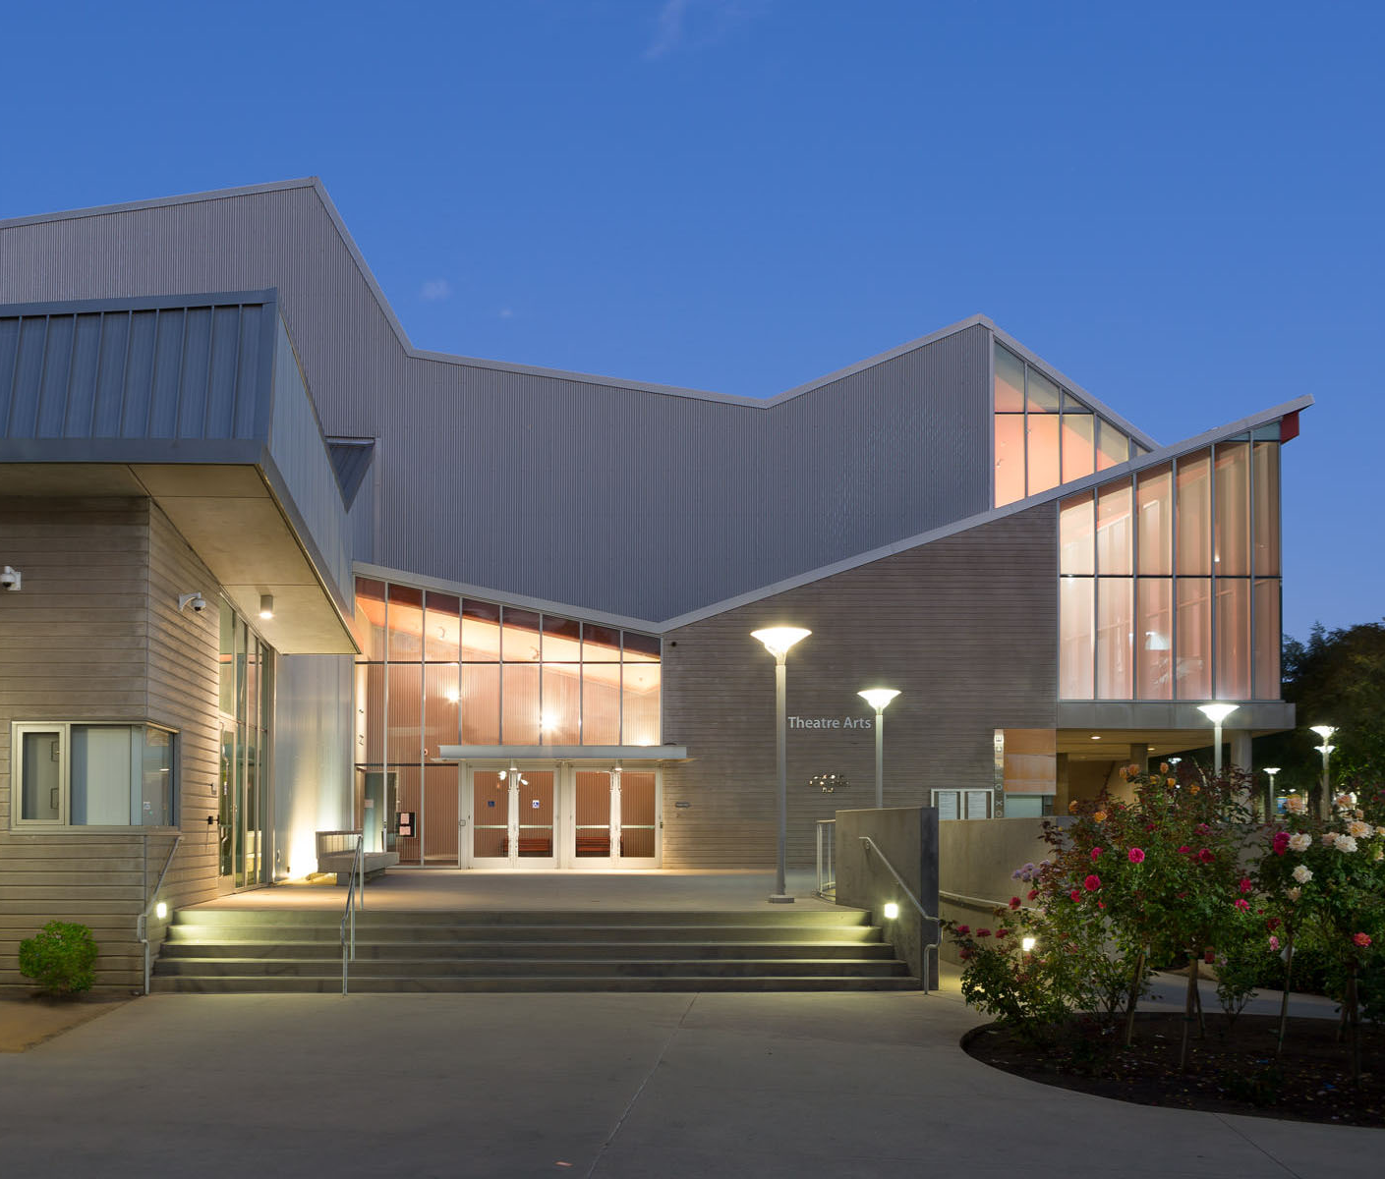
2015 ENR Best Project Award Category: Cultural/Worship California
2019 Gale Library Journal Library of the Year
Manhattan Beach Library Los Angeles County
Design-Build: HED | C.W. Driver

Slide 30
Crowell Public Library San Marino, CA
HED

Slide 31
Martin Luther King Hospital Expansion Inpatient Tower Expansion Los Angeles County, CA
Design-Build: McCarthy & Hensel Phelps, Architect: HMC

Slide 32
Saiful Islam, Ph.D., S.E.
Chairman / CEO
Ron Lee, S.E.
Principal
Saiful Bouquet Structural Engineers
155 N. Lake Avenue, 6th Floor
Los Angeles, CA 91101
T: (626) 304-2616
www.SaifulBouquet.com

